Slide 1
Liquidity Premia & Transaction costs
Authors: Bong Gyu Jang, Hyeng Keun Koo, Hong Liu and Mark Loewenstein
Published on: Journal of Finance
Presenter: Sijia Lou

Slide 2
Author
Fossett Distinguished Professor of Finance and Director of the Master's in Finance Program
Area of Expertise:
Asset Pricing, Financial Economics, Option Pricing
Research Interests:
Optimal consumption and investment with frictions, asset pricing, market microstructure
Selected Publications:
"So What Orders Do Informed Traders Use?", Journal of Business, 1867-1913, with R. Kaniel, 2006
"Optimal Consumption & Investment with Transaction Costs & Multiple Risky Assets", Journal of Finance, Issue 59, 289-338, 2004
"Optimal Portfolio Selection with Transaction Costs and Finite Horizons", Review of Financial Studies, 805-835, with M. Loewenstein, 2002
"Optimal Consumption of a Divisible Durable Good", Journal of Economic Dynamics & Control, 561-613, with D. Cuoco, 2000
"A Martingale Characterization of Consumption Choices & Hedging Costs with Margin Requirement",Mathematical Finance, 355-385, with D. Cuoco, 2000

Slide 3
Basic Concept
Liquidity Premia ( Liquidity Premium): The maximum expected return an investor is willing to exchange for zero transaction cost
Transaction cost: is a cost in making any economic trade when participating in a market.

Slide 4
Basic Concept
Frist Order Effect (Alter expected return)
Second Order Effect ( Alter trading strategy)
Why we care? We want to prove that transaction cost has a first-order effect on asset pricing.
Whereas, Standard Literature states that transaction cost only has a second-order effect on liquidity premia and asset pricing.

Slide 5
Standard Literature
GM Constantinides
Capital Market Equilibrium With Transaction Costs
Find LPTC ratio is smaller than one. Thus come to the conclusion that transaction costs only has a second-order effect on expected return and asset pricing

Slide 6
Assumption Difference
Standard Literature( Constantinides, Vayanos, Liu and Loewenstein, and Liu)
Assumption: Expected return, volatility and liquidity(transaction costs) constant through the investment horizon
Investment opportunity set constant
”Liquidity Premia and Transaction Costs”
Assumption: Expected return volatility and liquidity different in different market conditions( Bull & Bear).
Stochastic investment opportunity set

Slide 7
Model
Again, different from the model used in standard literature, the parameters used in this model will not be constant. There are two regimes: Bull & Bear. (regime i & j)
Probability Space
Uncertainty and the filtration: standard one-dimensional Brownian motion w and Risk: Two independent Poisson Processes ( Bull & Bear)
Two Assets: Risky(Stock) Risk-free(Bond)

Slide 8
Model
Optimal Investment Policies:
Solve using HJB

Slide 9
Ratios
No transaction cost (Using parameters used in Ang and Bekaert(2002) Base Case）
Stock investment to wealth ratio:
Bull: 2.5923
Bear: 0.6612
Consumption to wealth ratio:
Bull: 12.793%
Bear: 12.53%
Large difference
Similar

Slide 10
Ratios
With Transaction Cost
Calculate through the model that includes transaction cost
Stock to liquidated wealth ratio:
Bull: 1.9469-2.8934
Bear: 0.6005-0.9183 > 0.6612 (No transaction cost)
Consumption to wealth ratio:
Around 12.5% in both regimes

Slide 11
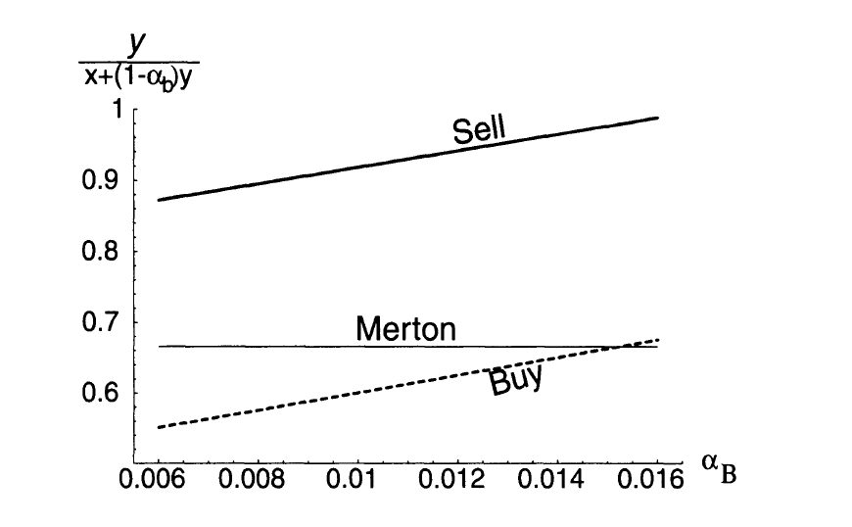
Trading strategy
Higher Transaction Cost
X axis represents the transaction cost in the bull market.
Y axis represents the fraction of wealth invested in stock
Notes:
When the bull market transaction cost is high enough relative to transaction cost in bear market. Investors are willing to hold more stocks to save on the transaction cost because bear market is usually shorter in average.

Slide 12
Trading strategy
X axis represents the transaction cost in the bull market.
Y axis represents the average liquidity premium to transaction cost ratio (LPTC)

Slide 13
Findings
Change in parameters in bull market has much more impact on optimal policy because bull market usually lasts longer.
LPTC(Liquidity premium to transaction cost ratio) could be well above one
The ratio is usually 4 times or even 10 times higher than the findings in Constantinides.

Slide 14
Comparison With constantinides
Investors trade more frequently in this model
Higher transaction cost
Y axis represents the expected time from purchase to sale( stock)
X axis represents risk aversion
Notes:
In this model, we can see the holding period is shorter. Trading frequency is higher. Total transaction cost is higher. Thus, investors are willing to pay more liquidity premia in order to have zero transaction cost, which is consistent with the result shown in slide 12. Also, the shape of these two models are difference because this model introduced two regimes. In the single regime, lower risk aversion means larger holding of stocks, high risk tolerance. Investors can hold stock for a long time and also reduce rebalancing cost. In the regime switch model, however, the investors need to take regime change future cost into consideration. They are thus, more willing to trade more frequent in one regime instead of have a large amount of transaction cost at the regime switching time. Especially when they have lower risk aversion, they have more holding of stocks.

Slide 15
Comparison with constantinides
Higher transaction cost
Y axis represents the Bull regime’s discounted lifetime transaction costs as a fraction of the liquidated wealth
X axis represents Risk Aversion

Slide 16
Comparison with Constantinides
Much higher transaction cost
Liquidity Premia to transaction cost much higher
Transaction cost along with a stochastic investment opportunity set has much more impact on expected return and asset pricing than what were stated in the standard literature.

Slide 17
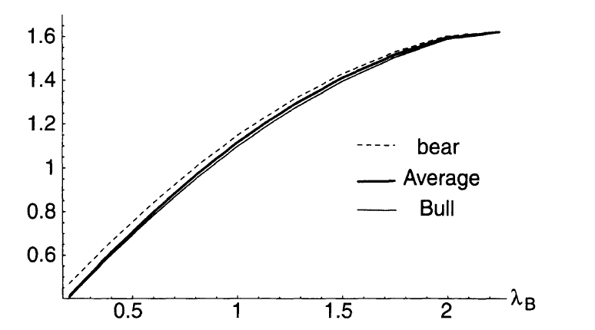
Bull & Bear
Y axis represents the Liquidity premium to transaction cost ratio (LPTC)
X axis represents Bull regime switch intensity
Y axis represents the liquidity premium to transaction cost ratio
X axis represents the expected return in bear regime.
Notes:
Although LPTC in this model is much higher than Constantinides. To have a LPTC higher enough to explain the premium puzzle need a frequency of bull regime switch as high as 2, which means a bull market can only last for 0.6 years. This is against the empirical observation. Thus, changing to a schocastic and two regime model is still not enough to explain the premium puzzle. However, the next graph which shows the LPTC as a function of expected return in bear regime confirm our hypothesis that LPTC has a first order effect on expected return and thus asset pricing.

Slide 18
Conclusion
Transaction costs can have a first-order effect on liquidity premia.
Transaction costs play a much important role in asset pricing than what was thought.
Transaction costs & stochastic investment opportunity set can partially explain premium puzzle
Further research can be done on introducing a liquidity crash regime which may produce even higher liquidity premia.

Slide 19
Thanks!

